Slide 1
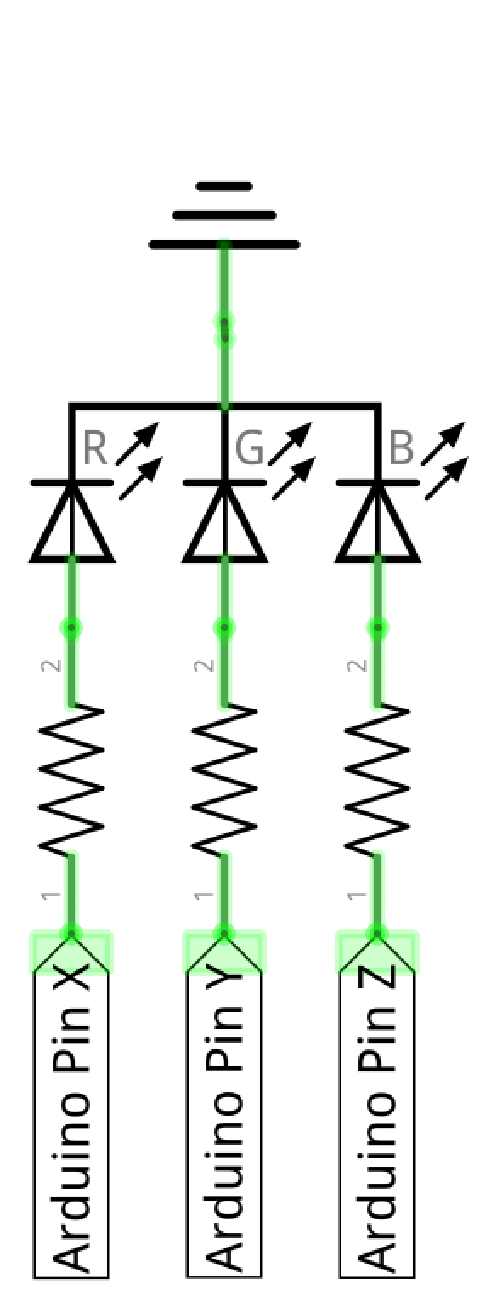
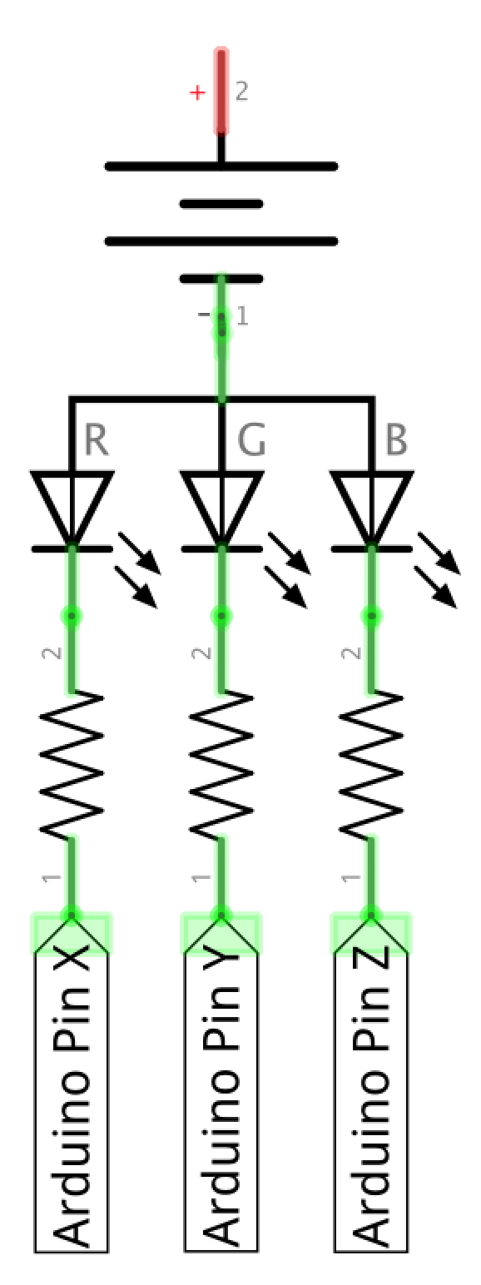
Common Cathode
Works
RGB LED
Common Cathode

Slide 2
Common anode
Common Cathode
R
B
G
R
B
(+)
G
(-)
Diffused RGB LED: Common Anode
https://www.adafruit.com/product/159
RGB Clear Common Cathode
https://www.sparkfun.com/products/105

Slide 3
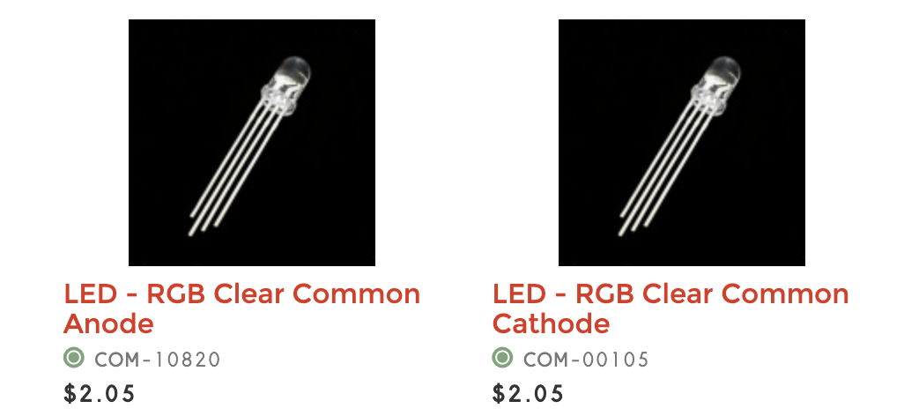
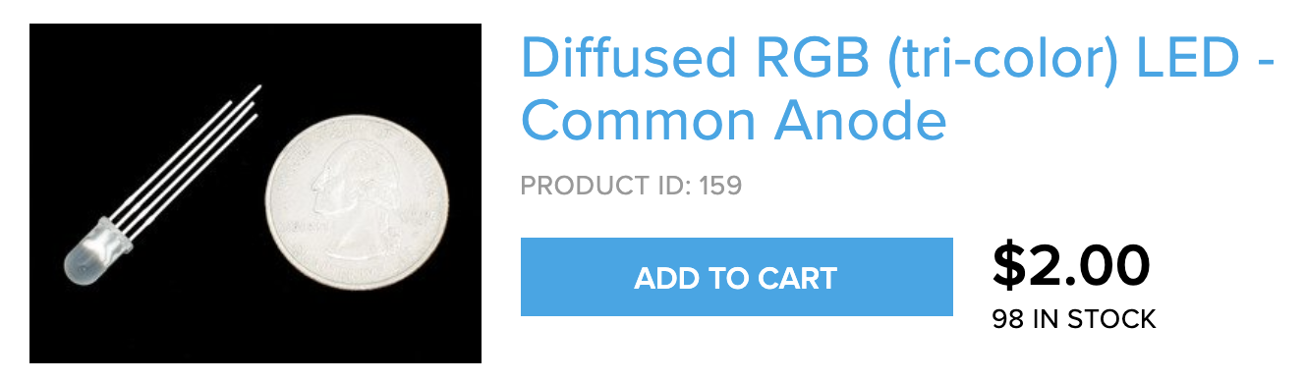

Slide 4
Common anode vs. common cathode
RGB LEDS
Common Anode (+)
Common Cathode (-)
Notes:
https://os.mbed.com/users/4180_1/notebook/rgb-leds/
https://randomnerdtutorials.com/electronics-basics-how-do-rgb-leds-work/

Slide 5
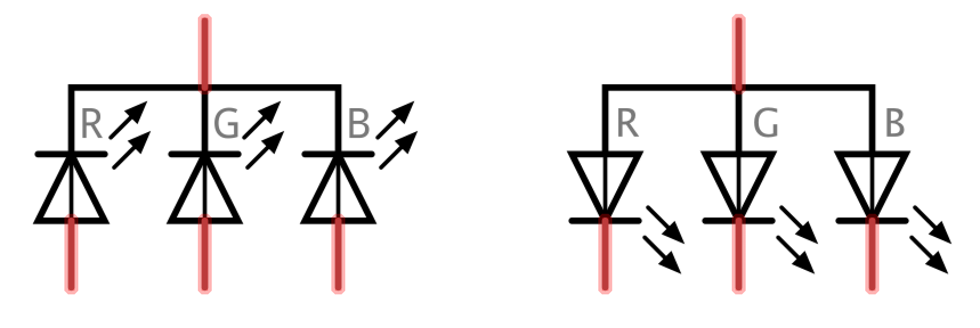
Common anode vs. common cathode
RGB LEDS
Common Anode (+)
Common Cathode (-)
Anode (+)
Cathode (-)
Higher voltage
Lower voltage
Current
flow
Current
flow
Lower voltage
Higher voltage
Notes:
https://os.mbed.com/users/4180_1/notebook/rgb-leds/
https://randomnerdtutorials.com/electronics-basics-how-do-rgb-leds-work/

